Slide 1
Three Year
Library Plan
2022-2025

Slide 2
School District of Mauston Library Mission
To foster a collaborative environment in which students feel encouraged to develop a lifelong passion for reading and inquiry, inspired to shift from consumers to creators, and emboldened to explore and create intersections between Science, Technology, Engineering, Art, and Math.

Slide 3
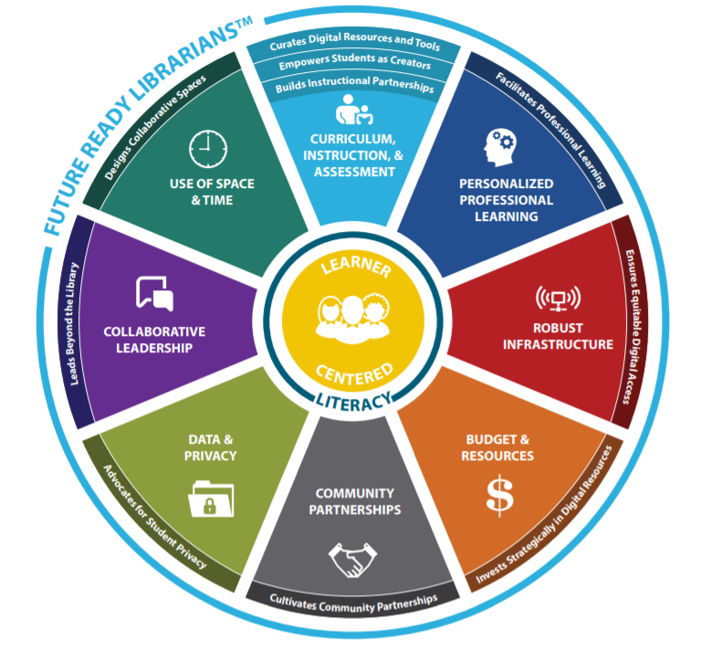
Future Ready Librarians
The School District of Mauston libraries are guided by the Future Ready Framework. As librarians, we collaborate with educators, families, and community members to ensure the students of the district are ready for the future. Through our professional practice, programs, and spaces, we lead, teach, and support our building and the district’s goals.
By connecting our work with the Future Ready Framework, we strengthen our practices, programs, and spaces to support existing & create new initiatives in our district.
Improvement & change is continuous. While continuing to use the Future Ready Framework to guide all library programming, over the next three years, we will focus on five specific goals across five sections of the Framework.

Slide 4
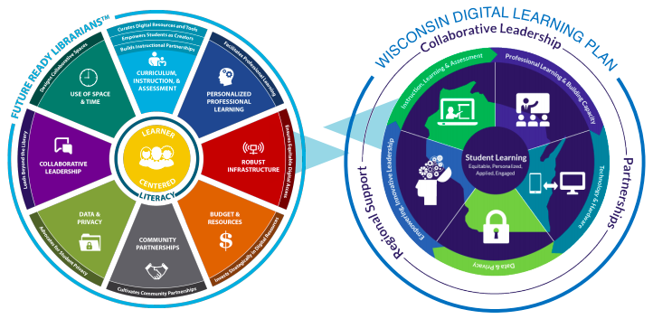
Wisconsin Digital Learning Plan
It is important to note that this framework focuses directly on the Wisconsin Digital Learning Plan and will allow us to create common language not only within our district but within the state.

Slide 5
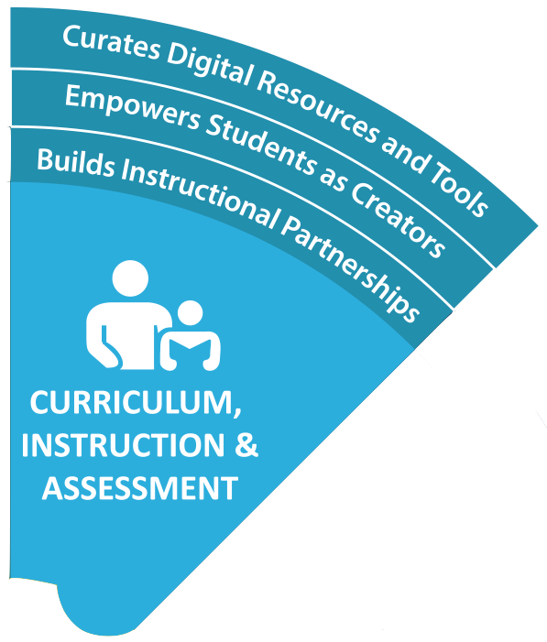
Current Status: Curriculum, Instruction & Assessment
Regular, consistent demonstrations by students in grades 3-8 creating intersections between Science, Technology, Engineering, Art & Math and core areas
Increased use of online resources by staff & students
Relevant electronic resources available to all students & staff, both on and off campus
Notes:
A future ready librarian builds instructional partnerships by partnering with educators to design and implement evidence-based curricula and assessments that integrate elements of deeper learning, critical thinking, information literacy, digital citizenship, creativity, innovation, and active use of technology.

Slide 6
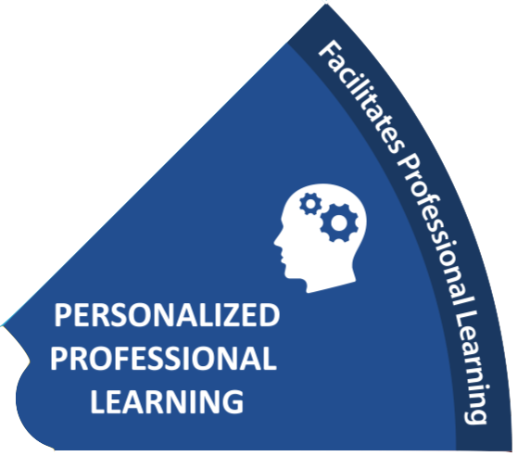
Current Status: Personalized Professional Learning
Keeps staff current in all resources available through the libraries
Provides learning opportunities for staff to aid in curriculum enhancement & personal enrichment
Seeks out & meets individual needs of staff
Notes:
A future ready librarian facilitates professional learning by leading professional learning to cultivate broader understanding of the skills that comprise success in a digital age including critical thinking, information, literacy, digital citizenship, and technology competencies.

Slide 7
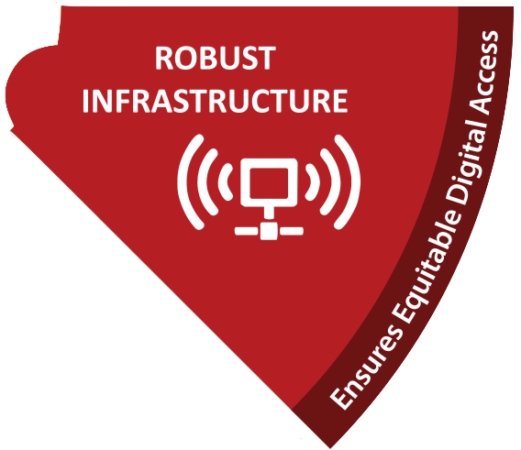
Current Status: Robust Infrastructure
1:1 devices grades K-12
Ability to check out hotspots to families
Relevant electronic resources available to all students & staff, both on & off campus
All buses outfitted with wireless access
Notes:
A future ready librarian ensures equitable digital access by providing and advocating for equitable access to connectivity, digital devices, information, resources, programming, and services in support of the district’s strategic vision.

Slide 8
Current Status: Budget & Resources
Open communication between library teams to determine best use of both district & Common Schools Funds
District support of library initiatives through funding
Annual Common School Fund amount is stable
Notes:
A future ready librarian invests strategically in resources by leveraging an understanding of school and community needs to identify and invest in resources to support student learning.

Slide 9
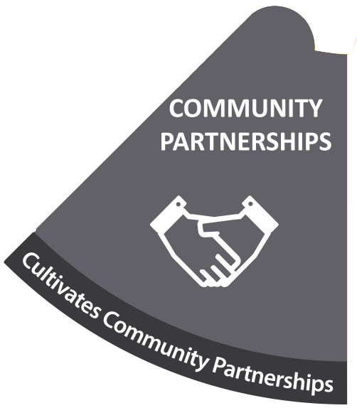
Current Status: Community Partnerships
Strong relationship with Hatch Public Library
Active participation in state & national conferences and chapters
Notes:
A future ready librarian cultivates community partnerships by seeking partnerships within the school and local community members and stakeholders to promote engagement and a lifelong learning process.

Slide 10
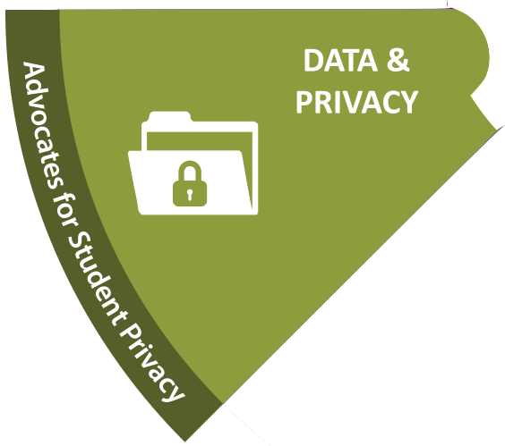
Current Status: Data & Privacy
Digital literacy instruction and reinforcement across K-12
Ethically and legally protect student and staff data & information
Notes:
A future ready librarian advocates for student privacy by teaching and promoting student data privacy through instruction and role-modeling for other educators.

Slide 11
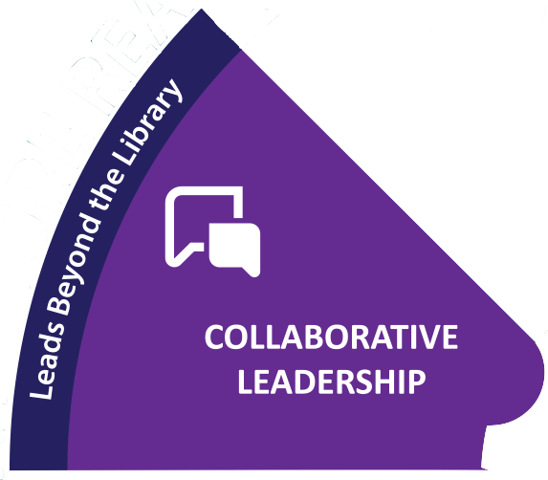
Current Status: Collaborative Leadership
Open communication between libraries & stakeholders
Regular informal collaboration with staff
Strong network of local, state & national PLCs
Notes:
A future ready librarian leads beyond the library by participating in setting the district’s vision and strategic plan for digital learning and fostering a culture of collaboration and innovation that empowers teachers and learners.

Slide 12
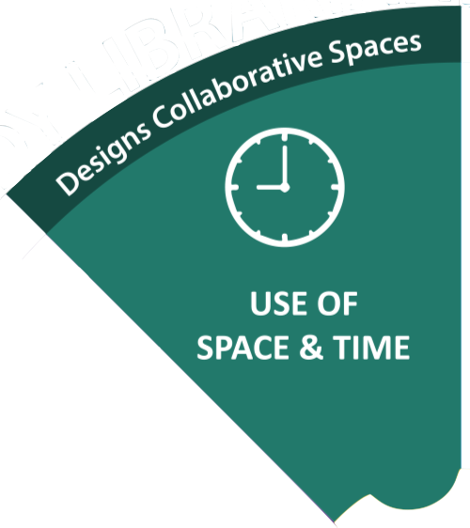
Current Status: Use of Space & Time
Meaningful library and Makerspace use by students and staff
District support in creating & updating library spaces
Library spaces are utilized for staff needs, after school programming
Notes:
A future ready librarian designs collaborative spaces by providing flexible spaces that promote inquiry, creativity, collaboration, and community.

Slide 13
Goals - Throughout the end of the 2025 school year, library media specialists in the School District of Mauston will focus on…
Examination & alignment of PK-5 library curriculum, structure & instructional time
Creating a comprehensive list of digital resources available & used in the District, complete with age restrictions, tool user policies, etc
Creating a dynamic schedule which allows for regular, meaningful collaboration between teachers & LMSs
Further engaging families and community members in promoting literacy and school-to-community partnerships
Teaching curation to students & colleagues as a future ready skill

Slide 14
Supporting Documents
School District of Mauston Mission
SDM Library Planning: Annual K-12 Library Budget
SDM Library Planning: Future Ready Framework
SDM Library Planning: Makerspace Curriculum Crosswalks
Wisconsin Common Career Technical Standards - 4Cs
SDM: Library Planning: Dynamic Status & Review of Program
AASL Standards Framework for Learners
ISTE Standards for Students
Wisconsin ITL Standards
Makerspaces & Equal Access to Learning
Wisconsin Common Career Technical Standards [WCCTS]
The Freedom to Fail Forward

